Slide 1


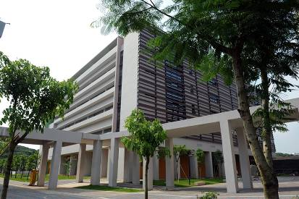
Engineering Electromagnetics 工程电磁场
Youwei Jia 嘉有为

Slide 2

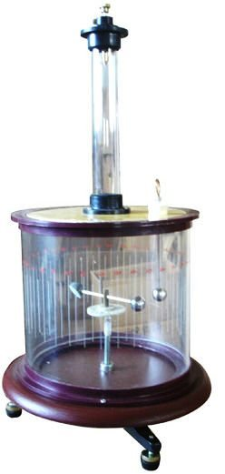
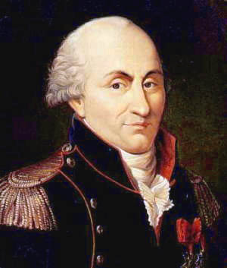
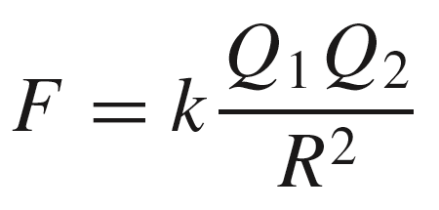
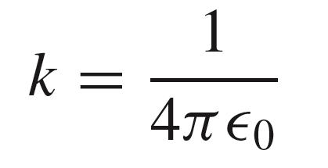
2: Coulomb’s Law库伦定律
Coulomb’s electrostatic force law 库伦静电力定律
Charles Augustin de Coulomb (1736－1806)
French physicist, French Army Engineers
Coulomb’s torsion balance库伦扭秤
Q₁
Q₂
+
R
+
F
Force of repulsion排斥力, F, occurs when charges have the same sign.
Charges attract each other when of opposite sign.
where
Note: Please compare the Coulomb’s electrostatic force law with the Newton’s
law of universal gravitation.
1

Slide 3
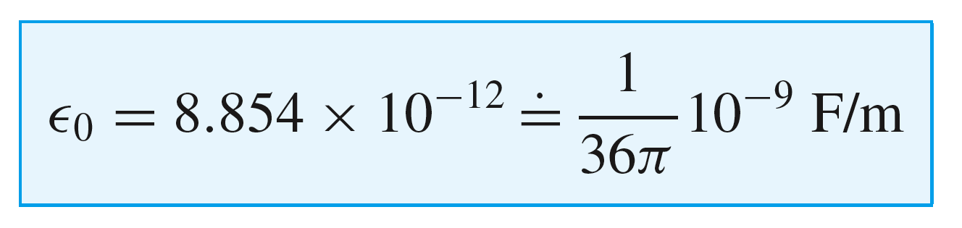
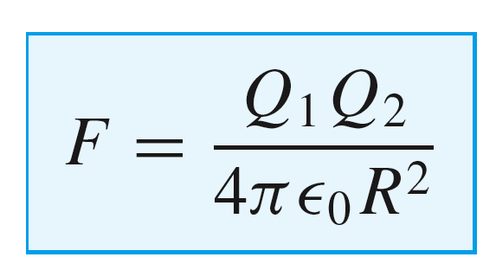
2: Coulomb’s Law库伦定律
Free Space Permittivity 自由空间的介电常数
where
F: Farad 法拉/法
with which the Coulomb’s force becomes:
Unit of Charge 电荷量单位: Coulomb, C 库伦，库
Elementary charge基本电荷量 (Charge of Electron or Proton)
=1.60217657 × 10⁻¹⁹ Coulombs
2

Slide 4
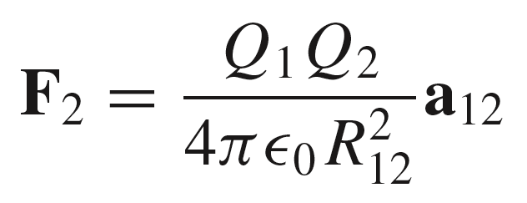
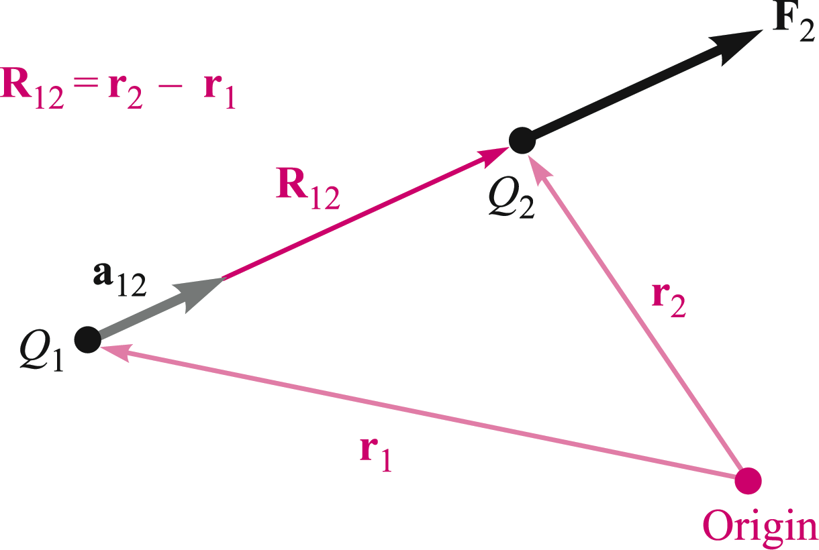
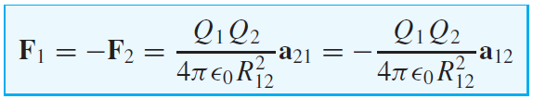
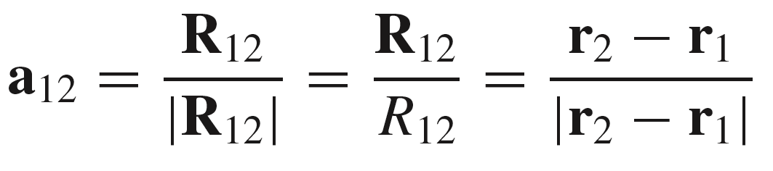
2: Coulomb’s Law库伦定律
Coulomb’s law in vector form 库伦定律的矢量形式
Q1. How to describe F₁?
3

Slide 5
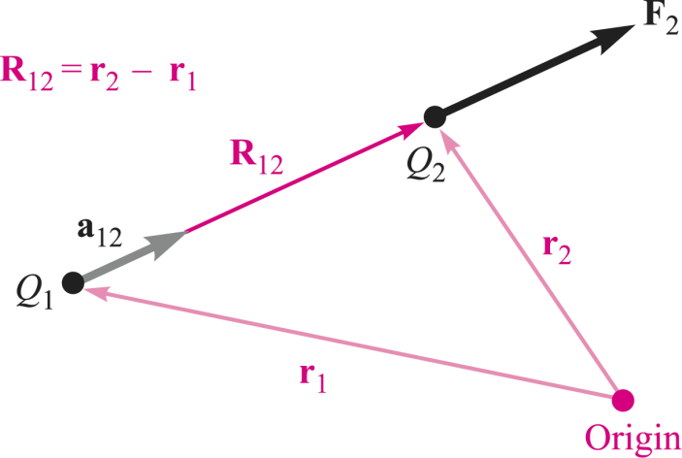

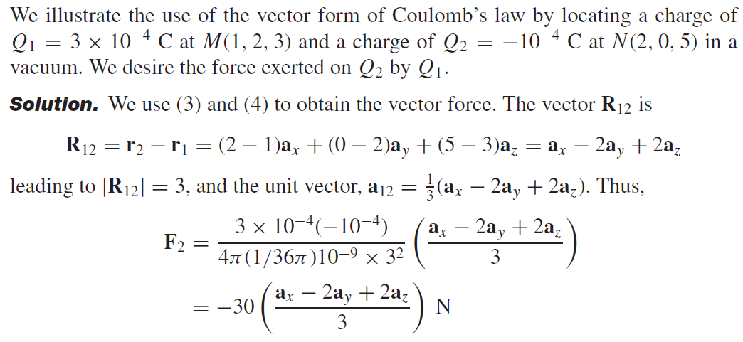
2: Coulomb’s Law库伦定律
Example
4

Slide 6
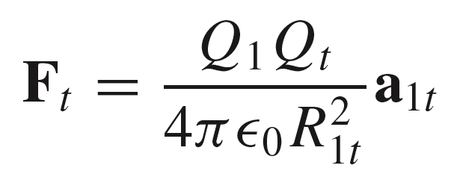

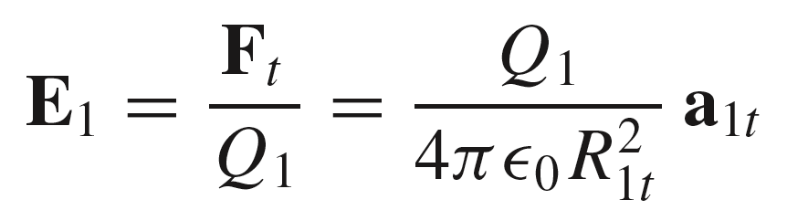

3: Electric Field Intensity电场强度
Unit test charge单位试验电荷
Consider the force acting on a test charge, Q_{t} , arising from charge Q₁:
where a_{1t} is the unit vector directed from Q₁ to Q_{t}
The electric field intensity is defined as the force per unit test charge, or
N/C
5

Slide 7
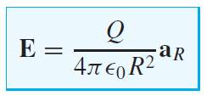
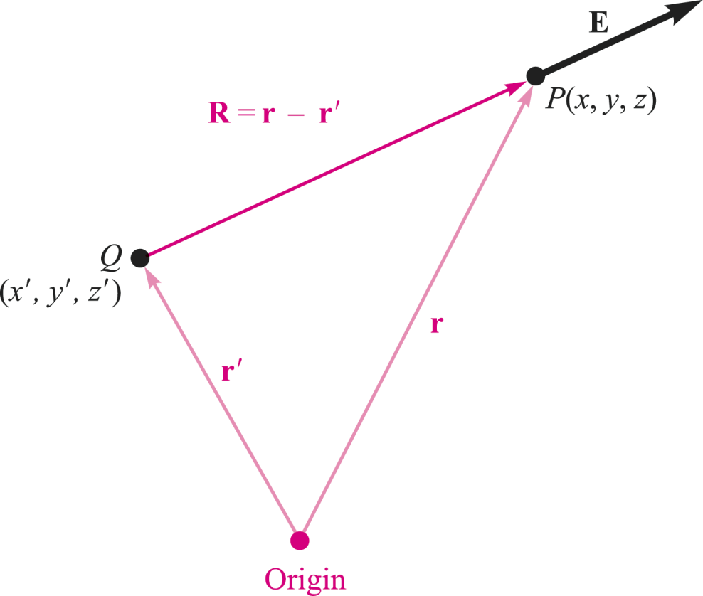
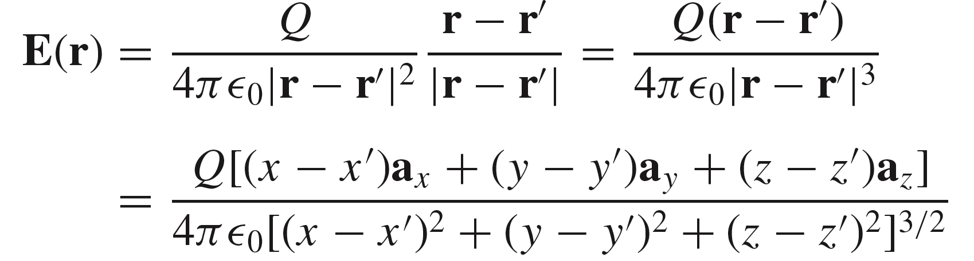
3: Electric Field Intensity电场强度
Electric field intensity
N/C
A more convenient unit for electric field is V/m. V: Volt 伏特
Q2. What is a_{R}?
Electric field of a charge off-origin
6

Slide 8
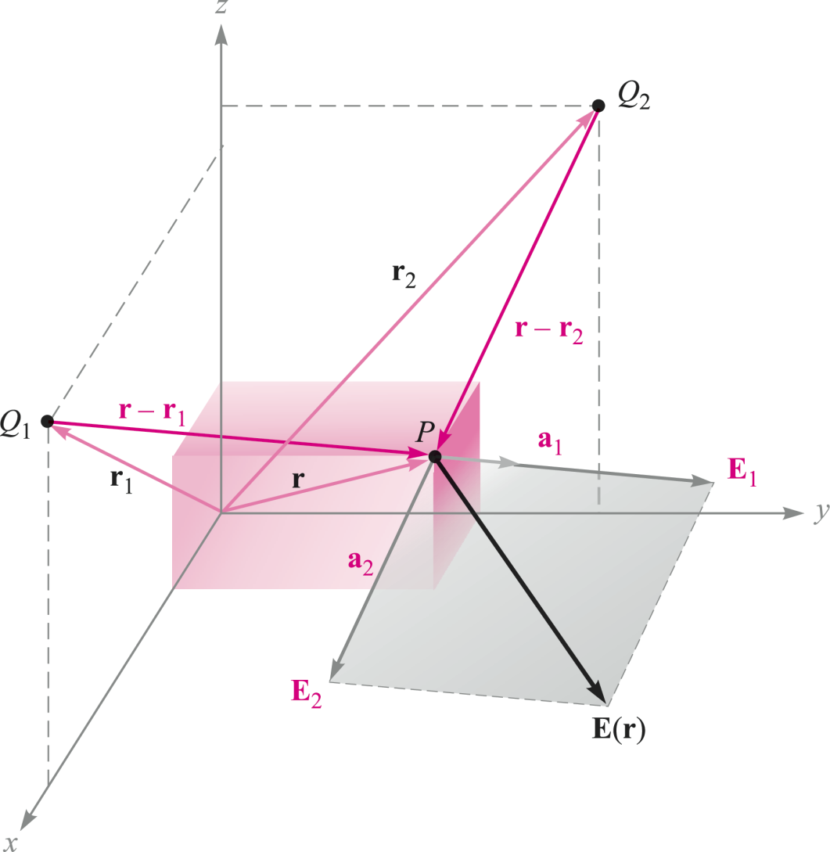
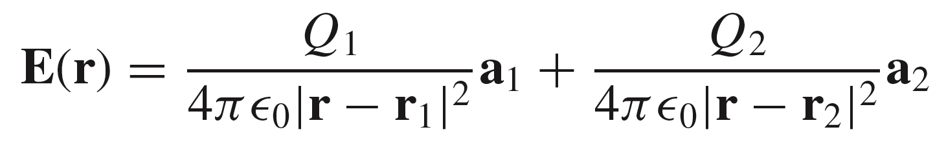
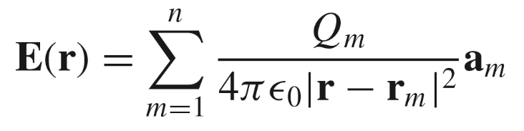
3: Electric Field Intensity电场强度
Superposition of fields from two point charges 电场叠加
For n charges:
Note: Static Electric Field in free space is linear!
7

Slide 9
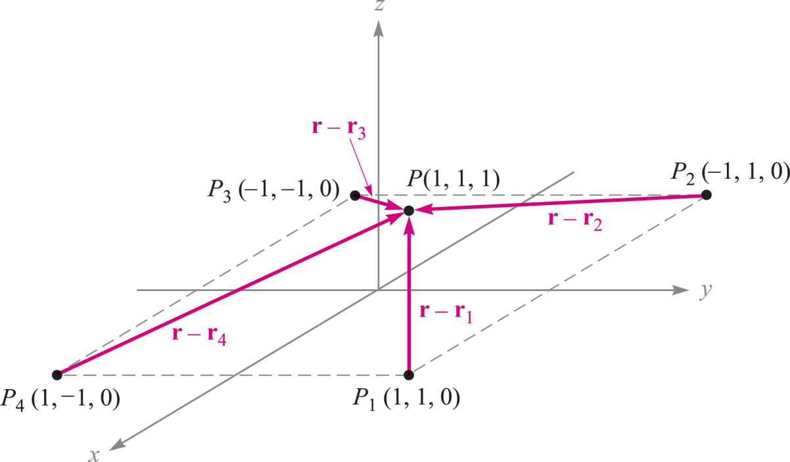




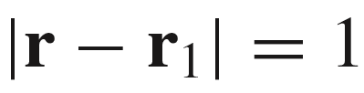
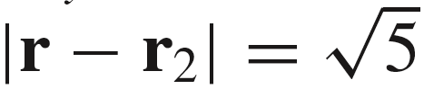


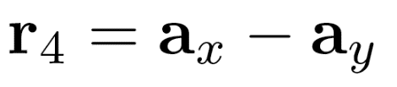
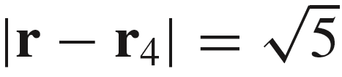
3: Electric Field Intensity电场强度
Example
Find E at P, using
Q_{m}=3nC
First, find the vectors:
Then:
8

Slide 10
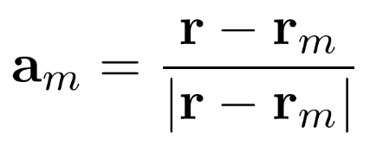
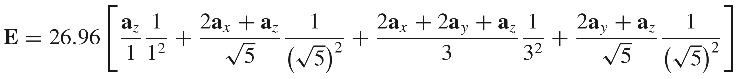
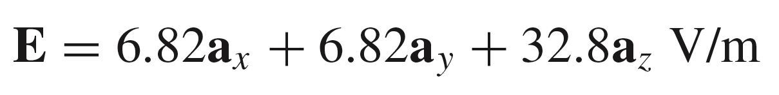
3: Electric Field Intensity电场强度
Example (Cont.’d)
Find E at P, using
where
so that:
9

Slide 11
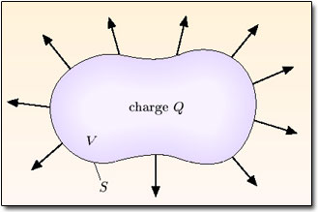
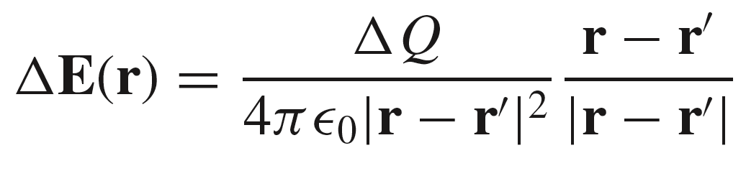
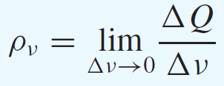
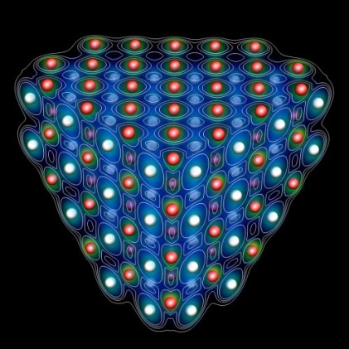

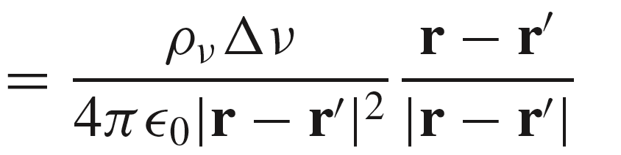
3: Electric Field Intensity电场强度
Electric field arising from a continuous volume charge distribution 连续分布体电荷产生的电场
We denote volume charge density体电荷密度 by ρ_{ν}, having the units of coulombs per cubic meter (C/m³):
10

Slide 12
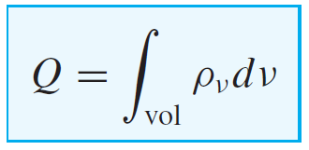
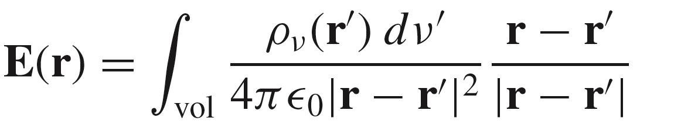
3: Electric Field Intensity电场强度
Electric field arising from a continuous volume charge distribution 连续分布体电荷产生的电场
Next, sum all contributions throughout a volume and take the limit as Δν
approaches zero, to obtain the integral:
Note: The vector r extends from the origin locates the field point where E is
being determined, whereas the vector r’ extends from the origin to the
source point where ρ_{v} (r’)dν’ is located.
11

Slide 13
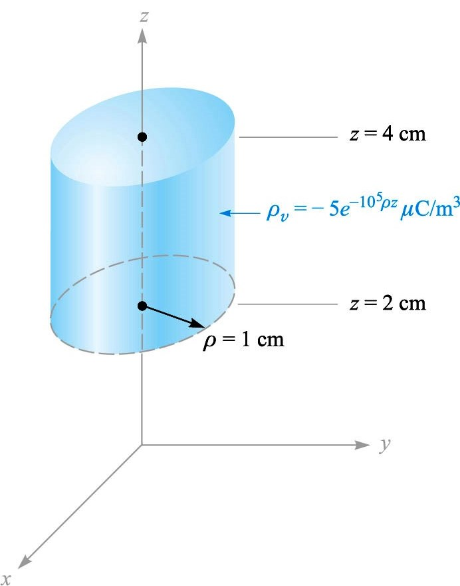

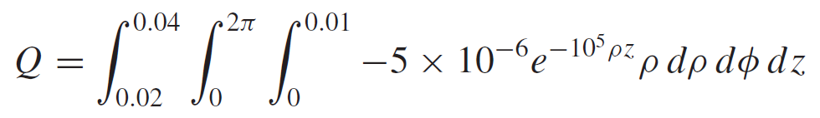
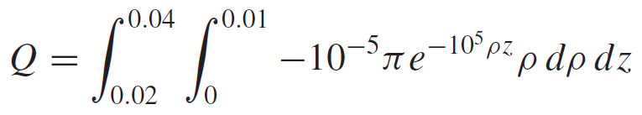
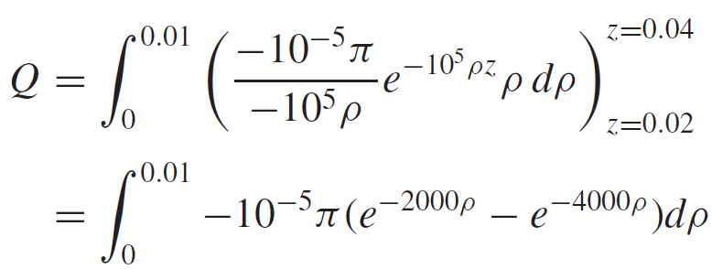
3: Electric Field Intensity电场强度
Electric field arising from a continuous volume charge distribution 连续分布体电荷产生的电场
Example: Find the total charge contained in a 2-cm length of the electron beam
3
12

Slide 14
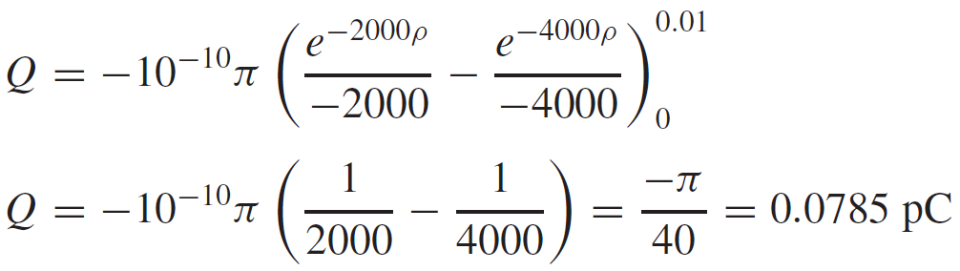
3: Electric Field Intensity电场强度
Electric field arising from a continuous volume charge distribution 连续分布体电荷产生的电场
Example (Cont’d): Find the total charge contained in a 2-cm length of the electron beam
Note: pico-couloms (pc皮库)，10⁻¹²C
13

Slide 15
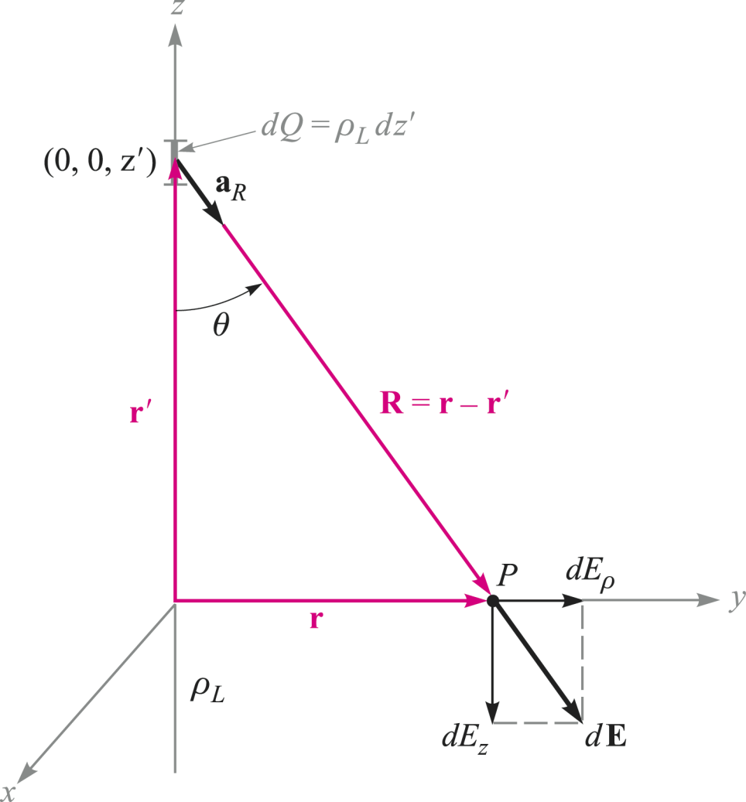
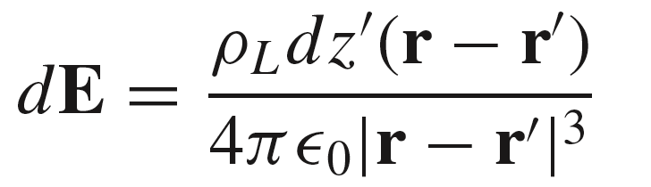
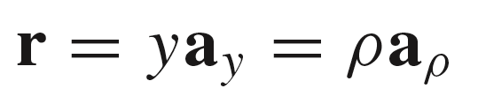
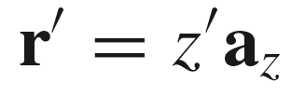
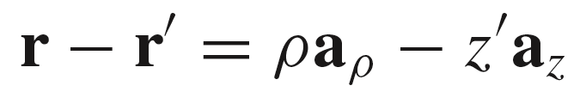
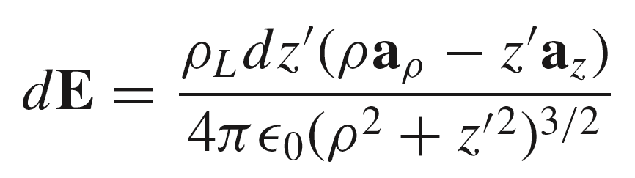
3: Electric Field Intensity电场强度
Electric field of a line charge 线电荷产生的电场
Line charge of constant line charge density 线电荷密度 ρ_{L} C/m lies along the entire z axis. (infinite line of charge)
At point P, the electric field arising from
charge dQ on the z axis is:
where
and
so that
Therefore
Note: Cylindrical coordinate is adopted herein.
14

Slide 16
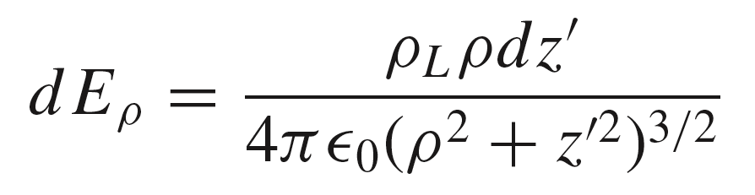
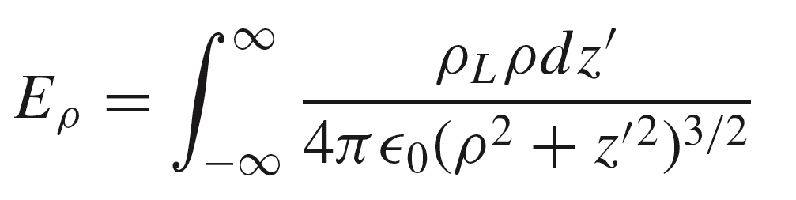
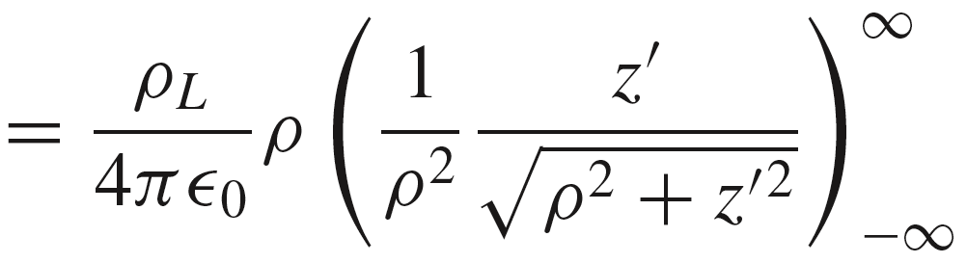
3: Electric Field Intensity电场强度
Electric field of a line charge 线电荷产生的电场
We have:
By symmetry, only a radial component is present:
15

Slide 17



3: Electric Field Intensity电场强度
Electric field of a line charge 线电荷产生的电场
Q3. How to describe in Rectangular coordinates?
Q4. How to choose coordinate system?
Q5. How to memorize this result?
16

Slide 18





3: Electric Field Intensity电场强度
Electric field of a line charge 线电荷产生的电场
Example: Off-Axis Line Charge
With the line displaced to (6,8), the field becomes:
where
Finally:
17

Slide 19



3: Electric Field Intensity电场强度
Electric field of a sheet of charge 面电荷产生的电场
Surface charge density 面电荷密度 ρ_{S} C/m²
Consider the electric field produced by the uniform surface charge of density ρ_{s} covers the entire y-z plane. (infinite sheet of charge)
We begin by writing down the line charge field on the x axis for a strip of differential width dy´, where we consider the x component of that field:
18

Slide 20


3: Electric Field Intensity电场强度
Electric field of a sheet of charge 面电荷产生的电场
Surface charge density 面电荷密度 ρ_{S} C/m²
The total field on the x axis is:
Q5. How to memorize this result?
Q6. Comparing P15 & P18, what
do you think?
19

Slide 21

3: Electric Field Intensity电场强度
Streamlines and sketches of fields电力线和电场分布图
How to visualize a electric field?
Consider the electric field caused by line charge
Let us be content to show only the direction of E by drawing continuous lines, which are everywhere tangent to E, from the charge.
These lines are usually called streamlines, although other terms such as flux lines通量线 and direction lines方向线 are also used.
Q6. Is it real that the magnitude of field can not be indicated with streamlines?
20

Slide 22


3: Electric Field Intensity电场强度
Streamlines and sketches of fields电力线和电场分布图
Methodology of Streamline Construction电力线的构建方法
The ratio of the y and x field
components gives the slope
of the field plot in the x-y plane
21

Slide 23






3: Electric Field Intensity电场强度
Streamlines and sketches of fields电力线和电场分布图
Methodology of Streamline Construction电力线的构建方法
Begin with the normalized line charge field in cylindrical coordinates:
Convert to rectangular components:
Then
whose solution is
Finally
22

Slide 24

3: Electric Field Intensity电场强度
Streamlines and sketches of fields电力线和电场分布图
Methodology of Streamline Construction电力线的构建方法
23

Slide 25






3: Electric Field Intensity电场强度
Streamlines and sketches of fields电力线和电场分布图
Methodology of Streamline Construction电力线的构建方法
$${\text{E}}_{x}=\frac{−8x}{y}$$
$${\text{E}}_{y}=\frac{4x^{2}}{y^{2}}$$
$$\frac{dy}{dx}=\frac{E_{y}}{E_{x}}=−\frac{4x^{2}}{y^{2}}\frac{y}{8x}=−\frac{x}{2y}$$
(a)
$$y^{2}=−\frac{1}{2}x^{2}+C$$
or
$$2y^{2}+x^{2}=C′$$
$$2ydy=−xdx$$
For P(1,4,-2), C’=33
23

Slide 26

HW-2
24

